Slide 1
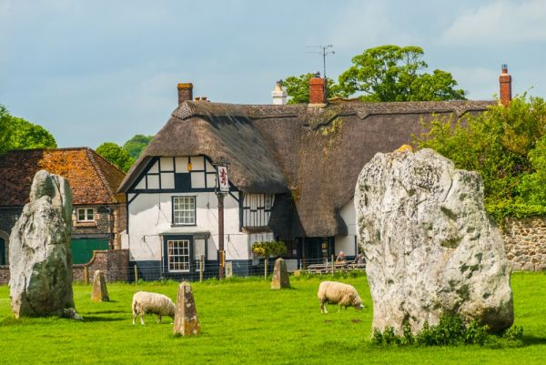
Avebury
this will teach you about AVEBURY!

Slide 2
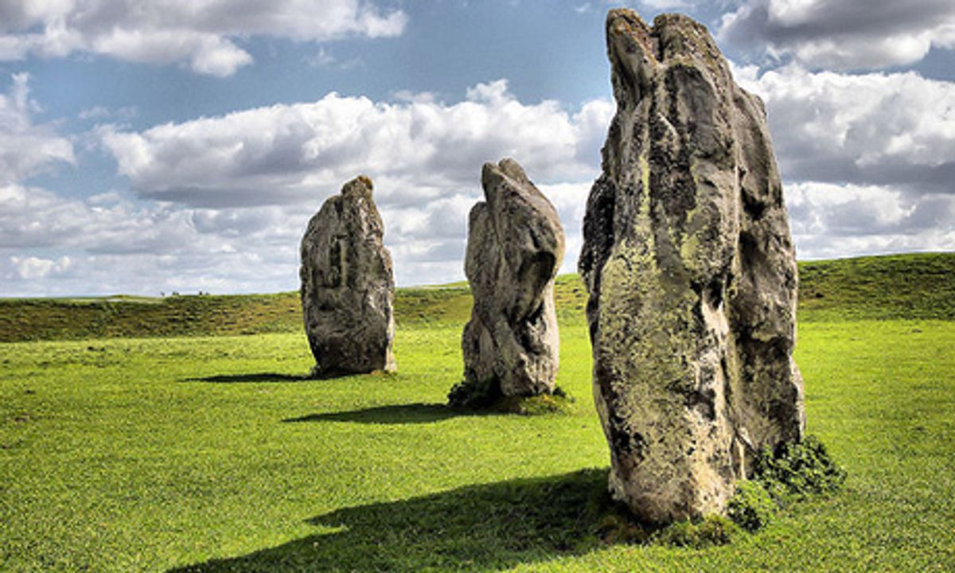
Stones!
Avebury is a place
with very strong rocks!

Slide 3
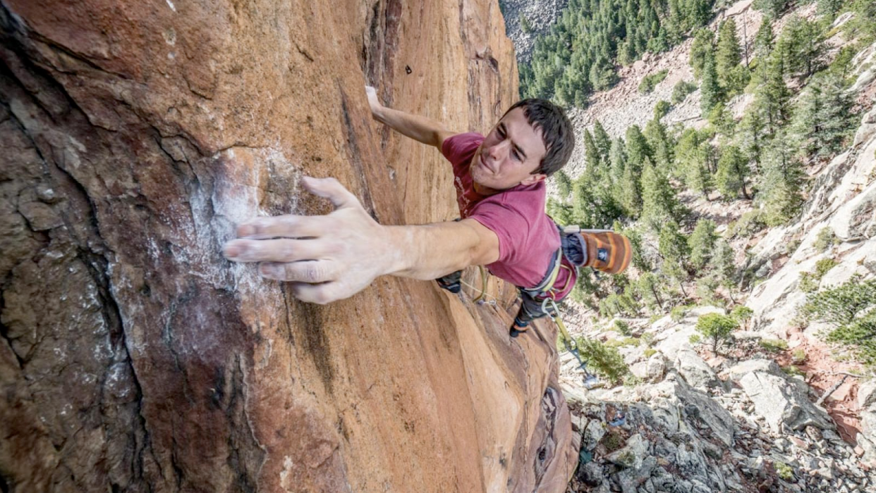
Stones arrival
The cave mans used rope and logs to move the rocks many other things to.

Slide 4
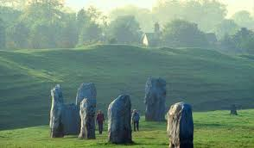
facts
Some stones were moved by logs, rocks and cave men! The stones were fat and strong and about 13 feet high!

